Slide 1
UCAS – Personal Statements

Slide 2
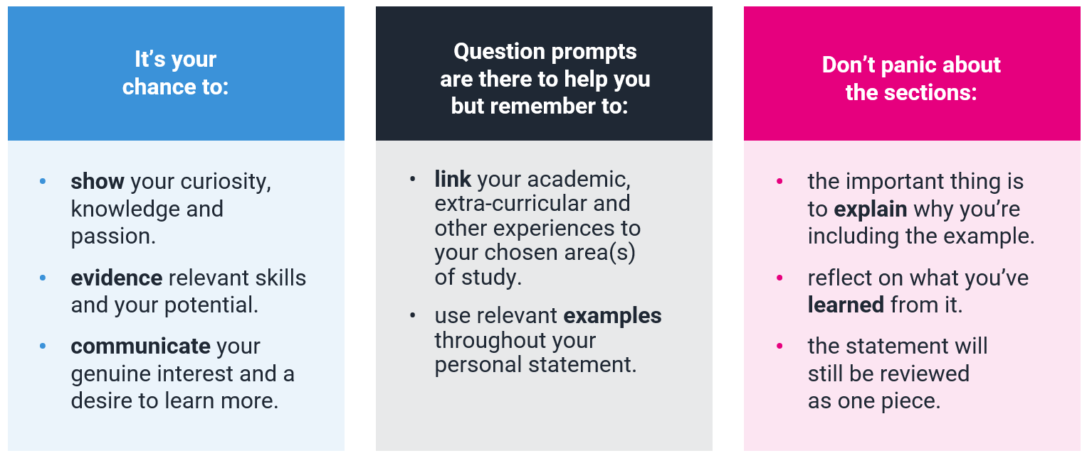
What is the purpose?
Remember there's no right or wrong!

Slide 3
Format and structure

Slide 4
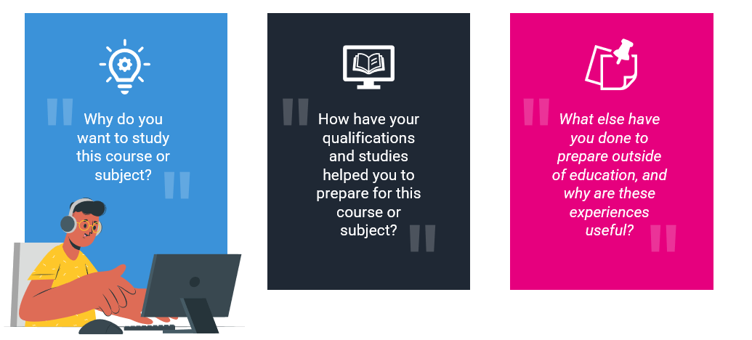
What are the questions?

Slide 5
Universities & colleges will consider
Have you chosen the course for the right reasons?
Do you have a depth of interest in the subject?
Do you appear motivated and committed?
Can you study independently?
Are you genuinely engaged and knowledgeable about the area you're applying to?
Notes:
For example, if you take law; the admissions team won't be impressed with 'I want to make a load of money' but 'I want to advocate for social change' is a much better answer. If you're talking about career prospects, emphasise how you're passionate about it and what you can GIVE as well as what you can GAIN.

Slide 6
Research is the foundation
Research and preparation is key when you’re starting to think about your personal statement.
Don’t worry about making your notes perfect; this is about checking you fully understand the course and have specifics to refer to in your personal statement.
Whether you know what you’re applying to or still considering your options, the more research you do the easier it will be to write.
Before you start writing anything, take some time to:
mind map what you might want to include
build up a bank of examples you can refer to
list evidence of your skills and experiences
rank your evidence and examples that are MOST relevant to the course(s) you're thinking of applying to

Slide 7
Where can I start?
There are lots of places you can start to research the details of the course(s) / subject you're looking to apply to.
Remember requirements may differ for each university or college, as well as depending heavily on the course. So, this research on your chosen area of study is vital before you start writing your personal statement.
Start by looking at the course description; this’ll help you with what to include and give you a good idea of what they are looking for.
If you visit a UCAS Discovery event, ask the university or college representatives.
Attend an open day and ask faculty staff what they like to see in the personal statement.
Use Unibuddy to speak to a student ambassador on a course you’re interested in.

Slide 8
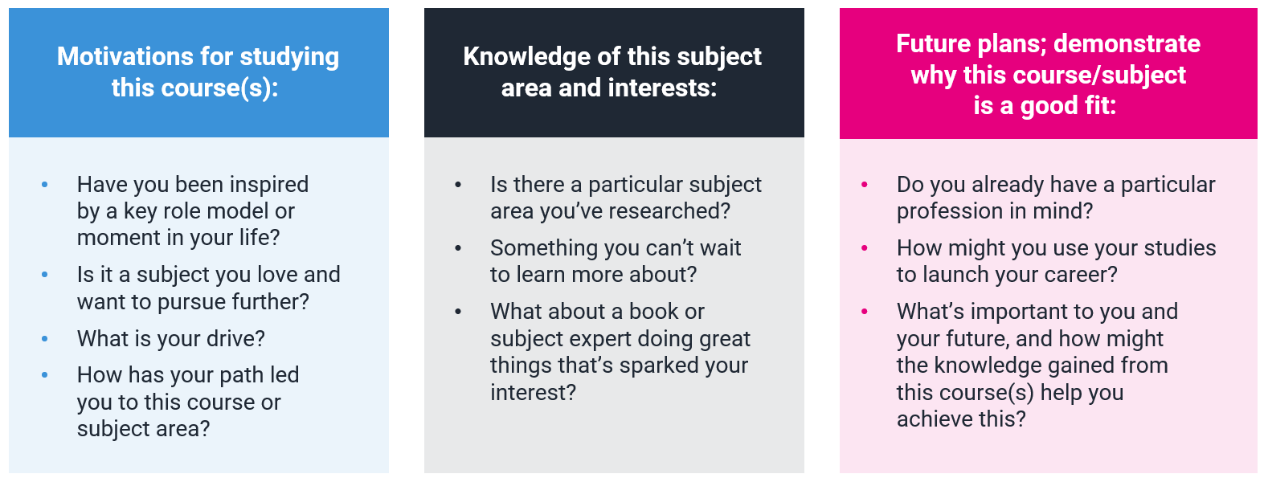
Q1: why do you want to study this course or subject?
You’ll want to show evidence of passion, curiosity and interest, this might include:
Remember these are just some examples, you don’t need to include it all. The key is to research the course(s) to find out what might be most relevant.
Notes:
Remind students that examples don't need to be something 'grand' or academic as the very first starting point if that's not the truth! If the starting point was something 'pop culture', social media or a holiday and they then expanded on this in depth through a variety of methods, then that's great as it shows progression!

Slide 9
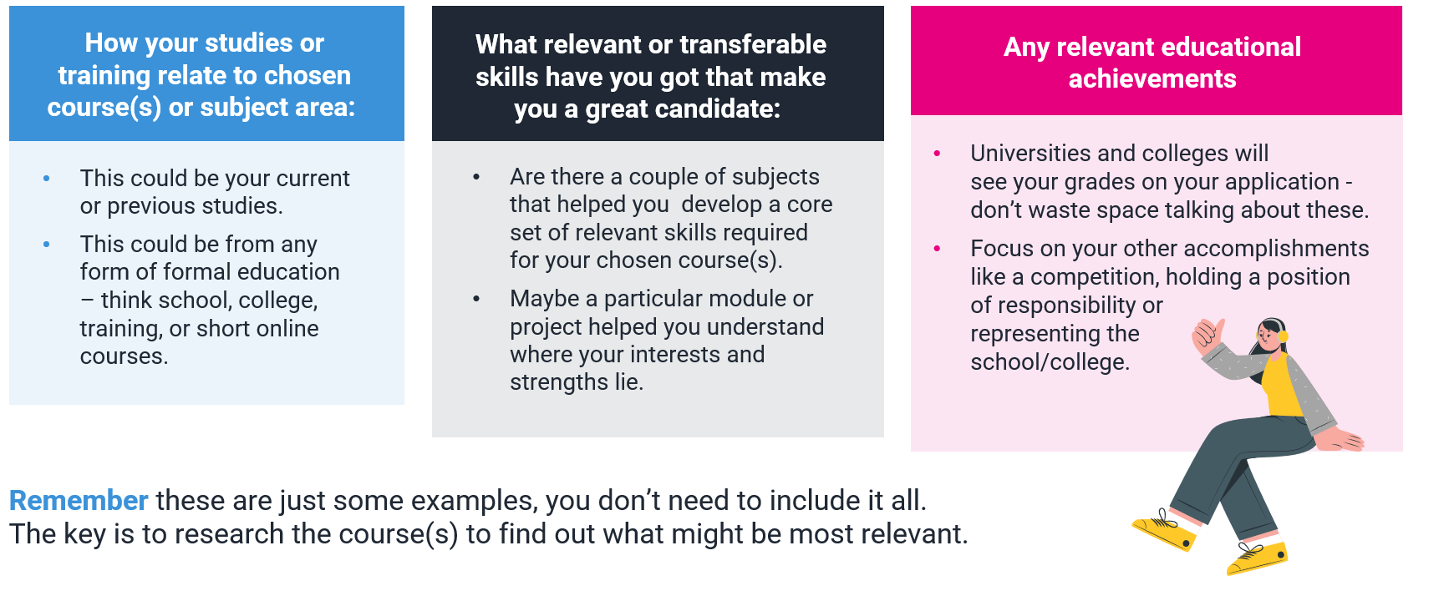
Q2: How have your qualifications and studies helped you to prepare for this course or subject?
Focus on what’s most recent and relevant to your subject or course(s), examples could include:

Slide 10
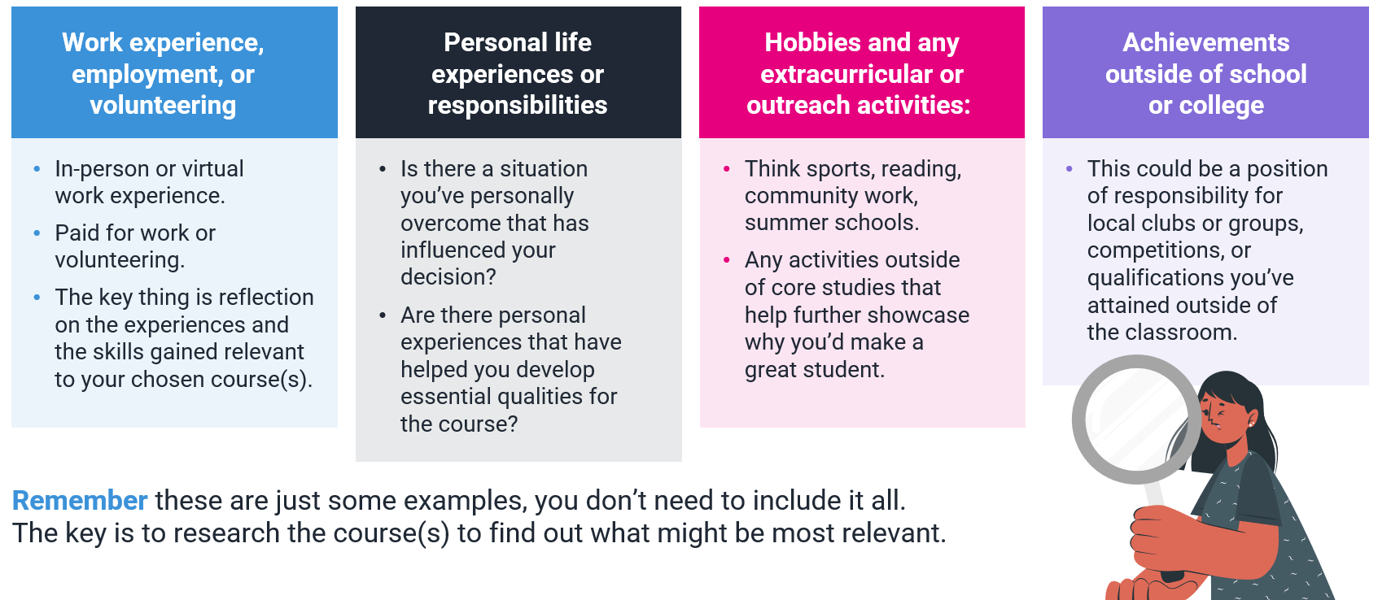
Q3: what else have you done to prepare outside of education, and why are these experiences useful?
Examples should be reflective and demonstrate further suitability for your subject or course(s), this could include:
Notes:
This is students' chance to talk about any other activities they have undertaken outside of their formal education or personal experiences which further demonstrate their suitability for the course. This section is likely to be highly personal to them and anything they do include should reflect on why they're including it.
Here are some more examples for this section:
Extra and super-curriculars
Volunteering
Personal life experiences e.g. caring for a family member, overcoming a challenge
Young enterprise
Work experience
Job/employment – part-time or full-time
Work-based learning/CPD
Shadowing
Online learning activities e.g. Springpod, MOOCs etc.
Tutoring
Trips and visits (online or in person) e.g. Museums, exhibitions, galleries, sites of historic interest, relevant sites connected to your course e.g. magistrate courts for law etc.
Podcasts, TED talks, documentaries etc.
Duke of Edinburgh/Duke of York awards

